Slide 1

Critical Risks for
Nonprofits 2024
Building Community Leaders, Impactful Nonprofits, and Thriving Communities
ntxnonprofits.org

Slide 2
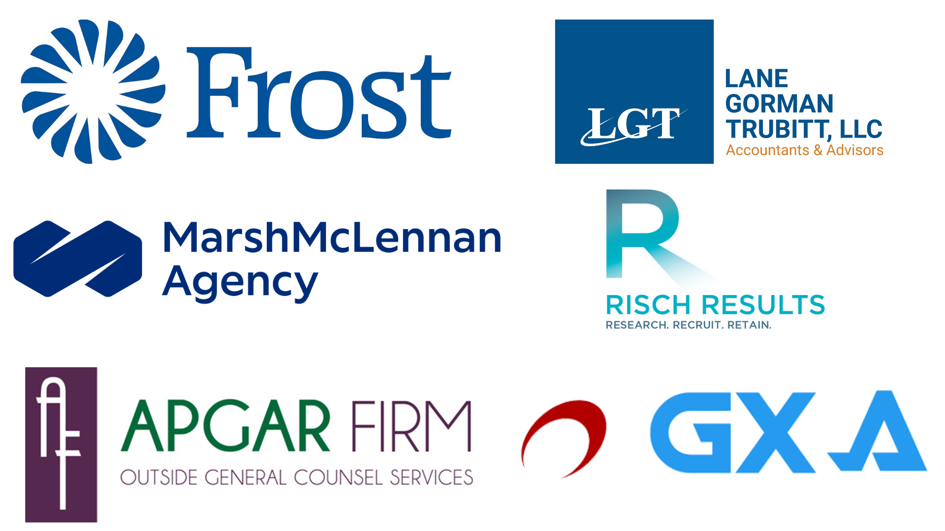
Thank You to Our Sponsors

Slide 3
Panel: Worst Case Scenarios – Things You Wouldn’t Believe
Building Community Leaders, Impactful Nonprofits, and Thriving Communities
ntxnonprofits.org

Slide 4
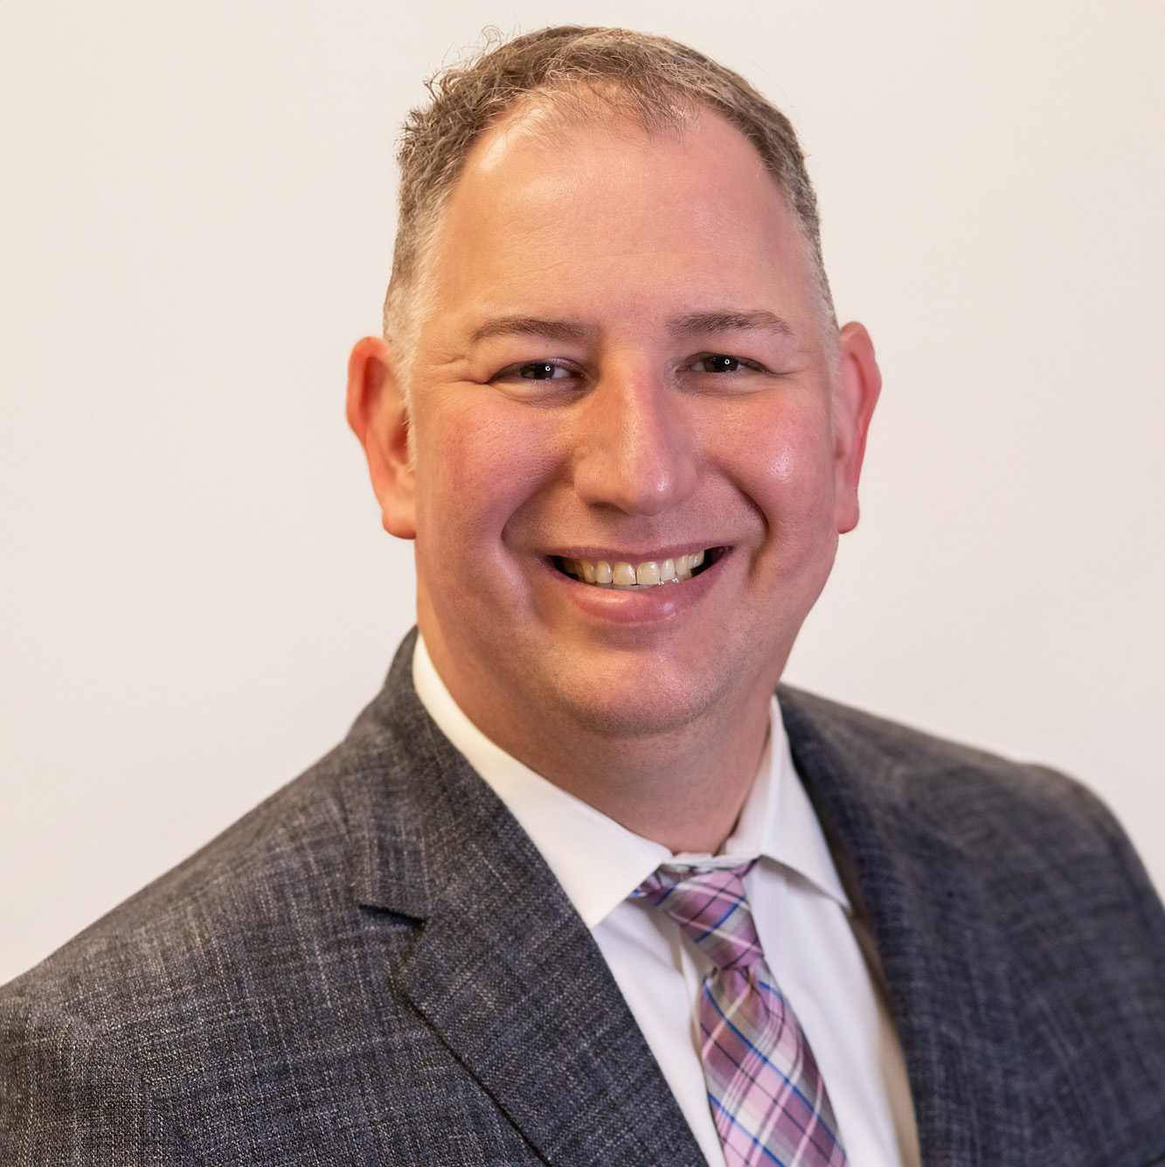
BYOB: Build Your Own Budget
Lucas LaChance

Slide 5
BYOB: Build Your Own Budget
(Now with Forecasting, too!)
Presented to: Critical Risks for Nonprofits
Date presented: February 16, 2024

Slide 6

Lucas LaChance, CPA, CIA
Partner, Practice Growth
Lucas is a Texas Society of CPAs Rising Star Award-winning relationship manager, auditor, board member, author, and speaker with two decades of leadership in assurance, consulting, risk management/mitigation, and taxation services. After nearly a decade as an auditor working with clients in a number of industries; including construction, M&D, and not-for-profit, he now is responsible for leading firm initiatives to expand existing client relationships and establish new ones, investigate innovative client services and solutions, and instill a culture of client service and sales. He often presents to local, state, and national audiences about accounting industry developments.
Areas of Interest
Not-for-Profit Services
Construction Services
Internal Controls Specialist
Retirement Plan Audits
Manufacturing Services
Dealer Services
Licensed In Texas
214.461.1467
llachance@lgt-cpa.com
University of Texas at Dallas
Bachelors of Arts—Literary Studies and Historical Studies
Masters of Science—Accounting and Information Management
visit www.lgt-cpa.com

Slide 7
Budgeting vs. Forecasting: Just Semantics, Right?

Slide 8
Budgeting vs. Forecasting
Budget (framework): Expectations for a company over time (annual)
  Estimates of revenue/expense
  Cash flow expectations
  Reducing debt
  Compares the actual result to determine the variance
Forecasting (activity):
  Data collecting for future budgets
  Updated periodically (time or triggering event)
  Indicates a need to make a change in plans
Frequently done on the same document

Slide 9
Back to Budget Basics: Methodologies

Slide 10
Budgeting Methods
Incremental budgeting: Taking last year’s actual results and applying a percentage up or down to obtain the current year.
  Pros: simple and easy to understand; good for when your cost drivers remain constant
  Cons: Likely to perpetuate inefficiencies by disincentivizing leaders to look for ways to cut costs or economize; creates budgetary slack by incentivizing leaders to overstate needs; ignores external factors in the supply chain that drive activity and performance.
Notes:
Cons: Consider your cost drivers this year in the pandemic. Likely several things (cleaning supplies, paper products, PPE, small medical equipment) was difficult to obtain or you paid a much higher than budgeted amount for essentials.

Slide 11
Budgeting Methods
Activity-based budgeting: Begin with targeted revenue and then determine amount of related expenses to achieve a certain net income
  Pros: Driven by historical data that is easy to obtain (generally); provides additional key metrics like revenue per program
  Cons: Can be divorced from cash flow where revenues don’t stack up requiring course correction on expenses

Slide 12
Budgeting Methods
Value proposition budgeting: method centers around three key questions
  Why is this included in the budget?
  Does this item create value for constituents, staff, the board, and community/stakeholders?
  Does the value of the item outweigh its cost? If not, is there another reason why the cost is justified?
  One man’s trash is another man’s treasure… This is a highly subjective approach, and the final arbiter holds extensive power.

Slide 13
Budgeting Methods
Zero-based budgeting: starts with the assumption that all program budgets are zero and need to be built each year.
  Pros: extremely tight process that focuses the organization on essential costs that have a direct impact on program profitability; excellent when there is a need for cost containment like financial restructuring, acquisition, or a global pandemic; frequently weeds out discretionary costs
  Cons: excessively time-consuming, should be used periodically rather than annually

Slide 14
Budgeting Methods
Three main types:
  Imposed budgeting: top-down process where management and the board adhere to organizational goals and imposes goals and constraints on lower levels
  Negotiated budgeting: a blend between top-down and bottom-up budgeting approaches. Often driven by broad management goals and guidelines but incorporates flexibility for input from managers and staff
  Participative budgeting: staff and managers make recommendations to management and the board

Slide 15
Controls to Help Prevent and Detect Potential Financial Statement Fraud
External audit of the financial statements
Management certification of the financial statements
External audit of internal controls over financial reporting
Budget to actual analyses
Comparison to prior year performance
Does the management team (not just the CFO) truly understand how to read the financial statements?
Distribute and discuss financial reports to staff
Flash reporting and dashboarding: What are our critical metrics, both financial and nonfinancial? What are the critical areas to review?

Slide 16
BYOB: Build Your Own Budget

Slide 17
Step 1: Project Revenue
Forecast annual, quarterly, and monthly revenues
  Identify your major revenue sources: grants, memberships, admissions, tuition, parking, contributions, online services, specialty services, nontraditional revenue
  Layer in industry changes and economic adjustments like COLA
  Address seasonality: kids out of school (spring break or summer), holiday lights
  Geography: environmental factors in different locations
  Consider ancillary services
Use conservative estimates: will your donor and customer base support projected revenues? Do you have marketing to drive base growth?
Prior year numbers are a helpful starting point
Notes:
The important thing about projecting your revenue is that you base your projections on real data. You cannot create projections based on the revenue you would like to bring in without having the system in place to support your goals. You need to base your projections upon the capabilities of your company. If you were a million dollar organization last year, it will be very hard for you to be a hundred million dollar organization in just one year. Therefore, base your projections upon realistic growth that will occur over time.

Slide 18
Step 2: Research Costs
Begin with fixed costs. Items like rent, utilities, phone, internet, accounting, legal fees, salaries, and advertising/marketing.
  Consider using average billing for utilities and putting professional services items like accounting, legal, and marketing on retainer for set monthly billing.
Layer in variable costs like costs of goods sold (inventory, small equipment), hourly labor costs, and commissions.
Plan for big ticket items like major equipment purchases, vehicles, leasehold improvements, facility construction
  Often these are part of a CapEx program or funded with loans, but loans have to be repaid and that becomes an additional fixed cost.
Notes:
Few tips:
Overstate costs in order to avoid underestimating expenditures
Marketing costs are always higher. If you think you have enough, you don’t.
If it is a new company, include start-up costs
Variable costs generally are tied to sales in some way. When you have a selling expense, that should trigger a consideration for variable costs.

Slide 19
Step 3: What are your KPIs?
Gross profit margin: Gross revenue, less adjustments (AR/AP discounts), less cost of doing business
Net revenue per program or service
Budget variance
Number of new donors
  Does your organization have a concentration of a handful of wealthy, influential donors? What happens when they die or your organization falls out of favor?
Average contribution per donor
Program, fundraising, and management & general ratios
Inventory, AR, and AP turnover
Liquidity, current, and quick ratios

Slide 20
Step 4: 12-Month Cash Flows
Revenue and cash flow are often two totally different things (accrual vs cash basis accounting)
Allow for payment terms
  Manage your receivables by collecting cash quickly
  Utilize payment terms with vendors—discounts for early payment or stretching out payment terms to 60 days instead of paying bills immediately
Allow for payment methods
  Make it easy for donors to pay you (online options, merchant services, consider outsourcing billing and collections)
  Evaluate how you pay your vendors. If there’s a finance charge for using a credit card for payment, write a check or ask if they have ACH options that do not carry a charge.
Plan for timing of big inflows/outflows

Slide 21
Step 5: Adjust for Slow or No Pays
Extend grace when you can; when you can’t, don’t.
Address habitual slow pays before it becomes an issue
Allow for bad debt
Create business policies to deal with late payments

Slide 22
Step 6: Adjust for Seasonality
Research the demand in the industry if you are establishing a new organization
Build savings during peak periods to cover the lean months (rainy day funds)
Flex staffing to meet demand and hire appropriately
Flex hours to meet demand

Slide 23
Step 7: Factor in Industry and Economics
The only constant is change; be nimble
When industry or economic disruptions happen, understand the impact on your organization; watch your KPIs
Consider the overall economic growth, macro and micro
Stay current through professional reading and business intelligence to adapt to change

Slide 24
Step 8: When and How to Spend
Identify and benefit from fixed costs where possible
Utilize a CapEx plan to determine when it is necessary to replace items like laptops, equipment, and leasehold improvements
Purchasing vs leasing
Understand how to determine the ROI on significant expenses, i.e. marketing or advertising

Slide 25
Step 9: Discuss Expenditures with Program Heads
Ensure buy-in from key management personnel
Identify unique one-off projects
Tie targets to performance

Slide 26
Step 10: Prioritize Investing
What to do with excess profits? Invest back into the organization, but where?
  Training/development
  Staff expansion
  Rainy day funds
Understand both long- and short-term goals
Utilizing an investment advisor as part of your overall service provider team (investments, legal, accounting/finance)

Slide 27
Step 11: Budget Reviews
Review budget-to-actual performance at least quarterly
Understand the impact of over and underperformance
Utilize dashboards and other graphical elements to communicate impact
Consult your accountant prior to any significant purchases

Slide 28
Step 12: Have a Plan B
Understand your industry risks; be aware of changes, new developments, and impactful legislation
Plan for underperformance
Again, have a rainy day fund to help smooth out the rough patches
The risk of loss of a major supplier, vendor, or class of customer is always a present risk
Review your insurance coverage at least annually as part of the budgeting process

Slide 29
Forecasting Best Practices

Slide 30
Forecasting: Final Notes
What is the intended end result?
  Grow, sell, sustain: These determine your KPIs
Each end result needs its own forecast
Goldilocks approach: expect best (or worst)
Not every variable can be addressed; keep the number of assumptions low
Time is your enemy
Roll with the punches

Slide 31

QUESTIONS?
askus@lgt-cpa.com

Slide 32
Critical Risks for
Nonprofits 2024
Building Community Leaders, Impactful Nonprofits, and Thriving Communities
ntxnonprofits.org

Slide 33
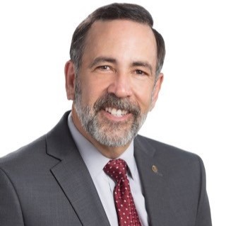
Financial and Reputational Risks Facing Nonprofits
Jeff Salavarria

Slide 34
Protection in a Digital Age
Notes:
Introduce ourselves

Slide 35
Fraud
Introduction
hack
danger
BANK
social
engineering
prevention
Social media
email
MALWARE
DATA
mobile
internet
spoof
Trogan
RANSOM WARE
PHISHING
online
email
ACH
HACKING
password
WIRES
DATA
THEFT
payment
FORGERY
scam
block
crime
BUSINESS EMAIL COMPROMISE
ONLINE
Social engineering
BREECH
DATA
PROTECT
skimmers
PASSWORD
Notes:
Purpose of presentation is to share different types of cybercrime and ways to mitigate risks.

Slide 36
The US government says that many of the recent cyber attacks against America have been sourced to operations in Russia and that Russia has responsibility for the ransomware attacks that are carried out from its territory and by one authoritative estimate, the world wide cost of cyber crime is expected to reach 10.5 trillion dollars by 2025.
Exponentially more than the damage inflicted from natural disasters in a year, and more profitable than the global trade of all major illegal drugs combined.
Notes:
Why all the talk about Cyber Crime and what to do to protect your business?

Slide 37
Payment Fraud
Protecting your bank accounts

Slide 38
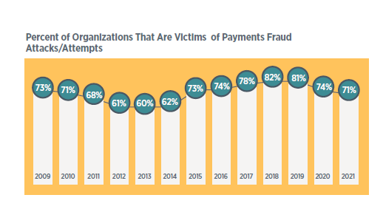

Slide 39
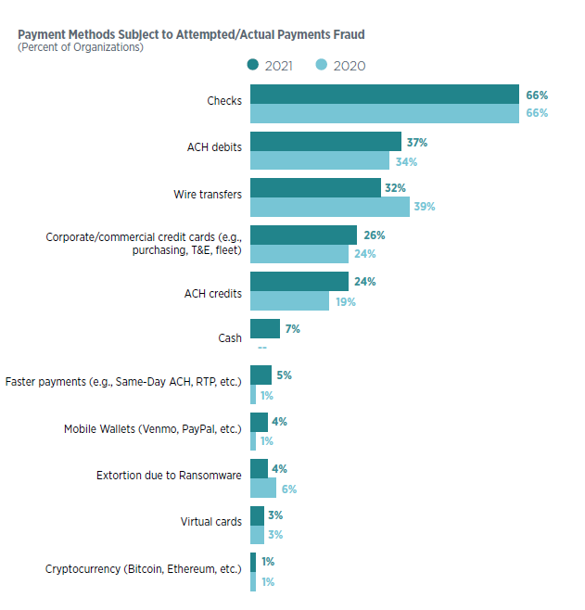

Slide 40
Tools to protect from payment fraud:
Reconcile your accounts daily
Separation of Duties
Implement Positive Pay
Implement ACH Filtering/Blocking
Consider making some accounts credits-only

Slide 41
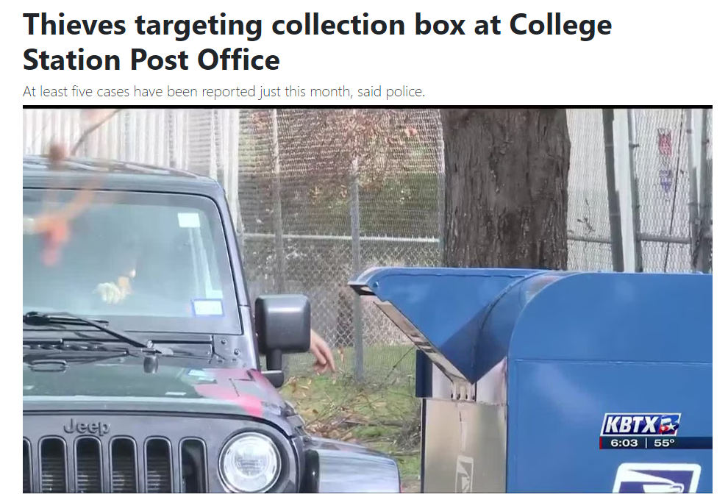
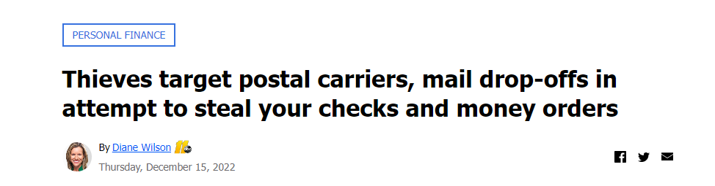
Other Recommended Steps
Eliminate physical checks when possible
If mailing checks, utilize mail drops INSIDE
the Post Office
Notes:
When you issue a check you are advertising your account information to the world.

Slide 42
Phishing
Think before you click. Over 90% of successful cyber attacks start with a phishing email.
Notes:
You all have heard this over and over, so why does it keep happening? Because we all get complacent and something looks enticing, so we click.

Slide 43




Email & Texts
Attachments, links, and apps can compromise devices
Frequently backup data and update devices
Delete unknown messages and turn off “auto-load” attachment feature
Only download apps from reputable sources
Notes:
Via email, on social media, or through mobile devices
Links can include URLs, images, music files, advertisements
Ransomware can be removed, but data will be destroyed… so back up frequently
Back up your data, but if the cloud apps are running on your PC, data backup could be destroyed
Verify authenticity by checking the web address or phone number on record
Messages can contain malware / Ransomware

Slide 44
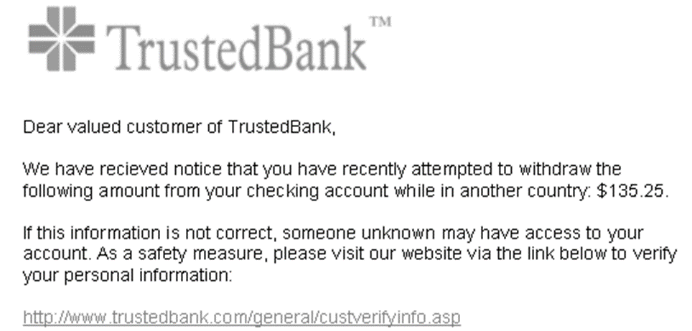
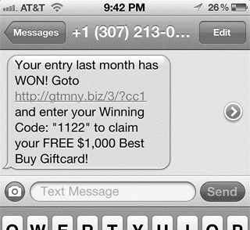
Fraud Signals
Emails and Text messages have similar signals to watch for
  Misspelled words
  Personal information verification
  Embedded link not matching the one on record
  Unfamiliar phone number
  Unexpected communication
  Inconsistency

Slide 45


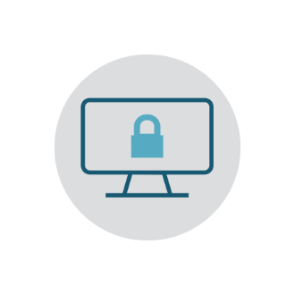

Search Engine
While web surfing or online shopping, a click on search results can lead to drive-by downloads
Stick with familiar businesses
Use secure websites
Use web browser vs clicking on search engine results
Notes:
Who could live without Google search? We look up retailers, restaurants and on and on. How many can say they just click on the link and don’t think a thing about it? These links can take you to a sight that has been set up to look like the real thing. You make a purchase and put in your credentials.

Slide 46
Business Email Compromise

Slide 47
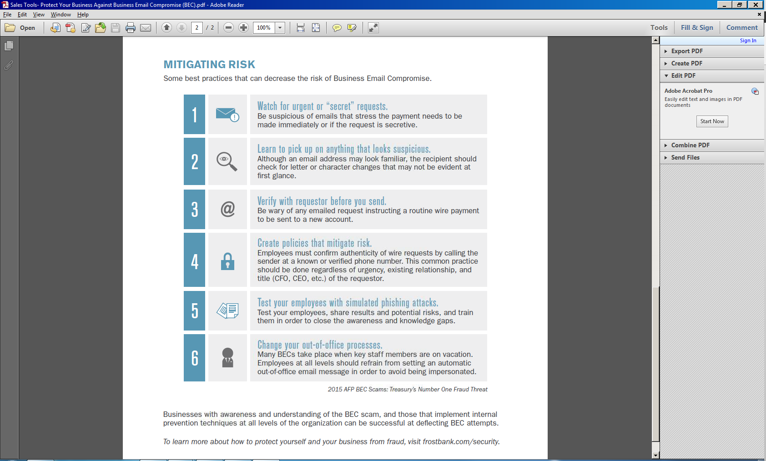
Business Email Compromise
Awareness, understanding, and implementation of prevention techniques throughout an organization can deflect BEC scams
Watch for urgent or “secret” requests
Create policies that mitigate risk
Learn to pick up on anything that looks suspicious
Test employees with simulated phishing attacks
Verify with requestor before funds are sent
Call CEO before sending that wire
Notes:
Watch for urgent or “secret” requests.
Be suspicious of emails that stress the payment needs to be made immediately or if the request is secretive.
Learn to pick up on anything that looks suspicious.
Although an email address may look familiar, the recipient should check for letter or character changes that may not be evident at first glance.
Verify with requestor before you send.
Be wary of any emailed request instructing a routine wire payment to be sent to a new account.
Create policies that mitigate risk.
Employees must confirm authenticity of wire requests by calling the sender at a known or verified phone number. This common practice should be done regardless of urgency, existing relationship, and title (CFO, CEO, etc.) of the requestor.
Test your employees with simulated phishing attacks.
Test your employees, share results and potential risks, and train them in order to close the awareness and knowledge gaps.
Many BECs take place when key staff members are on vacation.
Employees at all levels should refrain from setting an automatic out-of-office email message in order to avoid being impersonated.

Slide 48
Other Forms of Fraud
Emails or Letters from vendors requesting a change in payment processing
Emails from employees requesting a change in direct deposit for their paycheck
Notes:
I was asked for assistance by one of our customers for procedures to help with business email compromise. I told them they do not need any words written down, just one little sticker with a phone to remind them to never send a single penny based on an email request. ALWAYS pick up the phone on a number that you know and not one that is on the email.

Slide 49

Best Defense - Business Email Compromise
Notes:
I was asked for assistance by one of our customers for procedures to help with business email compromise. I told them they do not need any words written down, just one little sticker with a phone to remind them to never send a single penny based on an email request. ALWAYS pick up the phone on a number that you know and not one that is on the email or letter.

Slide 50
ALWAYS CALL TO CONFIRM ANY CHANGES IN PAYMENT REQUESTS!
Do not call the number provided in the email or letter
Call the number you normally utilize when dealing with the customer, even utilizing their cell phone to confirm

Slide 51
Examples seen at
Frost Bank

Slide 52
Incident Description:
Our client received a letter from their vendor on their letterhead informing them that they had changed banks and directing them to send all future disbursements under their construction contract to their new bank.
Incident Details:
Over a 3-month period the client remitted over $900,000 pursuant to the new directions. Only when the vendor called asking why they hadn’t been paid on their last three invoices did they realize that fraud had been committed.
Notes:
In this case we were able to recover most of the funds but recoveries are few and far between. This customer just got lucky that the receiving bank was on alert and put a hold on the account.

Slide 53
Incident Description:
Our Customer received an email from who they thought was an individual for the company they had been corresponding with on a $21 million payoff. Funds were to be wired to facilitate the payoff. In the email, the bank wire information had been changed from when they first spoke; however, the customer saw the amount was the same and thought wire instructions were correct and sent the wire.
Incident Details:
The receiving bank called Frost and questioned the wire because it was such a large amount and unusual amount for the beneficiary. The receiving bank placed the wire on hold until we could verify.
Frost contacted our customer numerous times asking if they had verbally verified the wire instructions. The customer insisted that they had and that the instructions were valid.
Frost contacted the receiving bank and shared that the client confirmed the instructions were correct.
90 minutes later the customer called Frost stating that the wire instructions were fraudulent.
Our wire team contacted the receiving bank that this was a fraudulent transaction and requested that the wire be returned.
Funds were returned three-business days later.
Notes:
Again, another lucky save. But note that if the $21MM had been sent and not recovered, the client was 1) out $21MM and 2) still owed $21MM on their loan.

Slide 54
Incident Description:
A week after visiting with the customer about Business Email Compromise, the customer remitted a wire that ended up being fraudulent.
Incident Details:
Our customer’s business administrator received an email from their Senior Pastor stating “as you know I am out of town and but I need you to wire funds today as noted below. I’ll get you the details when I return. The wire was for approximately $4,800. The wire was sent although the business administrator later shared that at the time he said “this doesn’t feel right” but submitted the wire, nonetheless. Only after sending the wire did he go back to the original email and noticed the email address was one letter off from the Senior Pastor’s true email address. He immediately called us.
Notes:
Another case were the receiving bank had already flagged the account suspicious, enabling us to recover the funds for the customer.

Slide 55
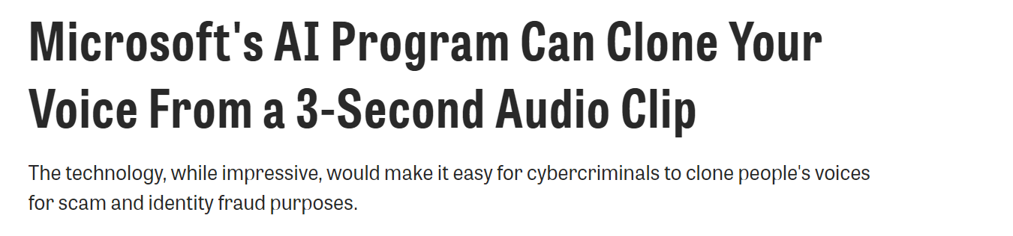
And just when you think it’s safe…
!
Notes:
Offer to call the client back (at a known number). Test the client with information only known to the real person.

Slide 56
How to Protect your Business

Slide 57
Recommended Steps:
Top-down buy-in from board and staff
Make risk-based decisions
Have an expert on staff or available for consultation
Have cyber policies & procedures
Have appropriate cyber security software
Have an action plan
Back up your data
Notes:
Does your corporate culture emphasis cybersecurity awareness? Is cybersecurity in the DNA of the company? Robust training for EEs? Is your cyber expert empowered to make changes? Is there any punishment to your EEs for failure to follow cyber protection?

Slide 58
Recommended Steps (con’t):
Turn off “out-of- office” message for key personnel.
Protect your computer hardware:
- Locked doors & security cameras
- Have dedicated PCs for certain tasks
- Regularly inventory your hardware
Have cyber training on password management and suspicious emails and links.
Cyber insurance
Notes:
Does your corporate culture emphasis cybersecurity awareness? Is cybersecurity in the DNA of the company? Robust training for EEs? Is your cyber expert empowered to make changes? Is there any punishment to your EEs for failure to follow cyber protection?

Slide 59
Cyber Insurance
Key Components of a Good Cyber Policy
First Party Coverages
Notification and Credit Monitoring Costs
Cyber Extortion Fees (Ransome)
First dollar coverage for a breach coach
IT Forensic Costs
Data Recovery Costs, Software Restoration
Business Income
Notes:
In 2021 and 2022 we would ask our customers who were requesting credit how they were responding to COVID. That has changed. Now we are asking how the organization is prepared for cyber attacks. This is due to its possible impact on an organization’s ability to service any debt with the bank.

Slide 60
Cyber Insurance
Key Components of a Good Cyber Policy
Third Party Coverages
Legal fees
Regulatory Fines and Penalties
Third Party Lawsuits
Settlement and Court- Ordered Judgements
Notes:
In 2021 and 2022 we would ask our customers who were requesting credit how they were responding to COVID. That has changed. Now we are asking how the organization is prepared for cyber attacks. This is due to its possible impact on an organization’s ability to service any debt with the bank.

Slide 61
Cyber Insurance
Cyber Liability Policies – BEWARE!
Not all policies are created equal (sub-limits, coinsurance, insured requirements)
Is coverage afforded for prior acts?
Is the policy “reimbursement” or “pay on behalf of?”
Is there an Acts of War exclusion?
Company requirements – MFA? Engineering call back requirement
Notes:
In 2021 and 2022 we would ask our customers who were requesting credit how they were responding to COVID. That has changed. Now we are asking how the organization is prepared for cyber attacks. This is due to its possible impact on an organization’s ability to service any debt with the bank.

Slide 62
Questions?

Slide 63
Thank You
Disclaimer: The information herein has been obtained from sources believed reliable. While we do not doubt the accuracy of the information or its sources, we have not verified them and make no guarantee, warranty or representation about them. It is your responsibility to independently confirm the accuracy and completeness of the information. You and your legal advisors should conduct a careful, independent investigation of the information herein to determine to your satisfaction the suitability of the information for your needs.
Notes:
So before I say goodbye, I would like to encourage each of you to have that birds and bees talk with your employees about practicing safe computing.

Slide 64
Critical Risks for
Nonprofits 2024
Building Community Leaders, Impactful Nonprofits, and Thriving Communities
ntxnonprofits.org

Slide 65

Revitalizing Your Team: How NFP Leaders Can
Reclaim Talent & Reduce Turnover
Jolene Risch

Slide 66


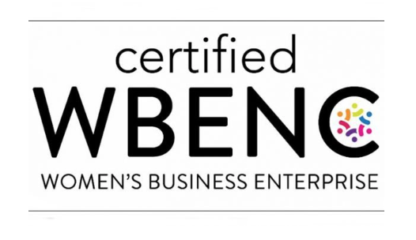


Revitalizing Your Team
How NFP leaders can reclaim talent and reduce turnover
RischResults.com
972.839.9447
JoleneRisch@RischResults.com
Notes:
Peace Corps Haiti and Costa Rica
Volunteer and Board Service
NFP Clients

Slide 67
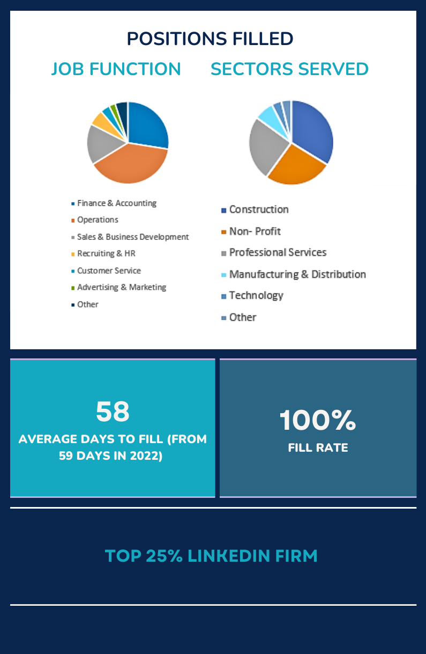
Risch Results
We Believe…
Great teams blend diverse ideas, and experiences
Each search should be unique and customized
Leave no stone unturned in a search, from passive employed candidates to talent that extends far beyond our personal connections
Meaningful relationships with our clients help us deliver better results.
Our communities cannot be inclusive and equitable unless our organizations are
The workforce is ever-changing; our knowledge and approach should evolve too

Slide 68


Agenda
Recruiting and retention in the NFP community
Reducing turnover
Becoming a talent magnet
Compensation as a key to hiring and retention
Pay comparison and equity issues
Anticipated compensation trends for 2024

Slide 69
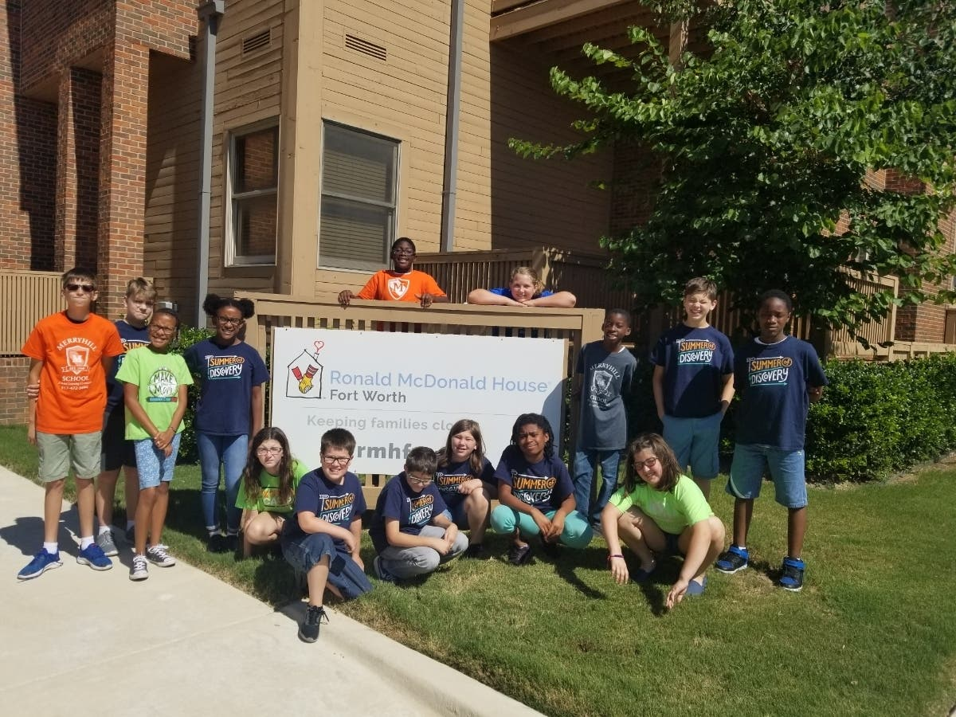
Social Impact Staff Retention Survey, 2024
Michelle Flores and Evan Wildstein authored the first SISR
74.2% of NP professionals will look for a new position this year
  34.7% of those looking will stay in nonprofit
  65.3% are not sure or will look outside of nonprofit
82% of NP professionals with less than 10 years of exp, will look for a new position
69% of NP professionals with more than 10 years of exp, will look for a new position

Slide 70

Recruiting and Retention Challenges in the NFP Community
Mission fatigue and competitive burnout
Resource constraints and competitive disadvantages
No development opportunities (58%)
Compensation/benefits (57%)

Slide 71
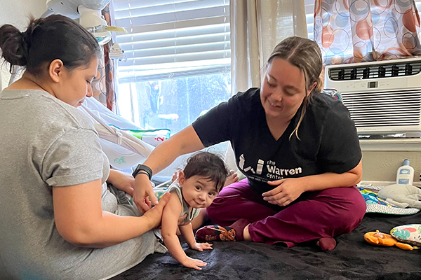
Reducing Turnover
Understanding why talent leaves
The significance of feedback and staying attuned to staff needs
Developing a positive work environment
Non-financial retention strategies
  Flexibility (82%)
  Supportive management/leadership (62%)
  Fair compensation/benefits (64%)

Slide 72

Becoming a Talent Magnet
Showcasing the organization’s culture and mission
Leveraging technology and social media to engage potential talent
Case study of successful recruitment campaigns

Slide 73

Compensation as a Key to Hiring and Retention
Impact of COVID on compensation
Compensation strategies to help hiring and retention
Pay transparency and equity issues
2024 anticipated compensation trends

Slide 74
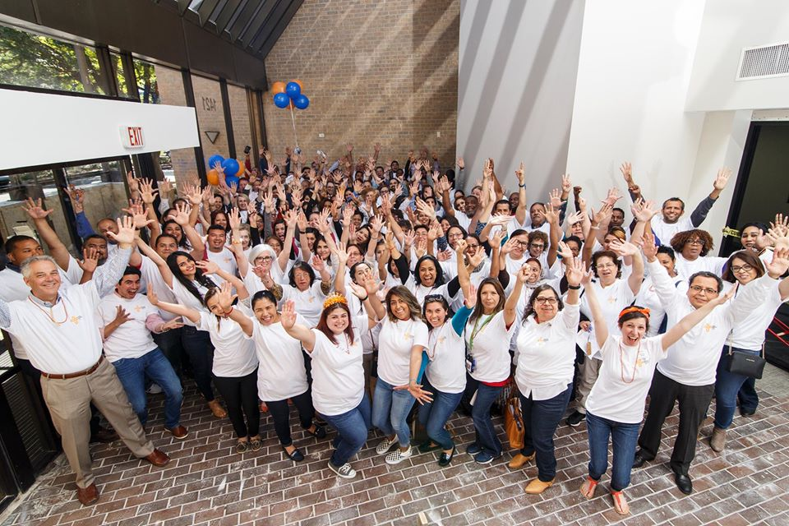
Compensation Strategies To Help Hiring And Retention
Adaptive and resilient compensation strategies
Benchmarking and market analysis
Focus on total rewards and non-monetary benefits
The real cost of an employee
How to make these strategies work

Slide 75

Anticipated Compensation Trends for 2024
Salary expectations for 2024
Increased emphasis on total compensation
Performance-based pay
Non-traditional benefits
Inflation and cost of living adjustments
Technology in compensation management
Sustainability-linked compensation

Slide 76
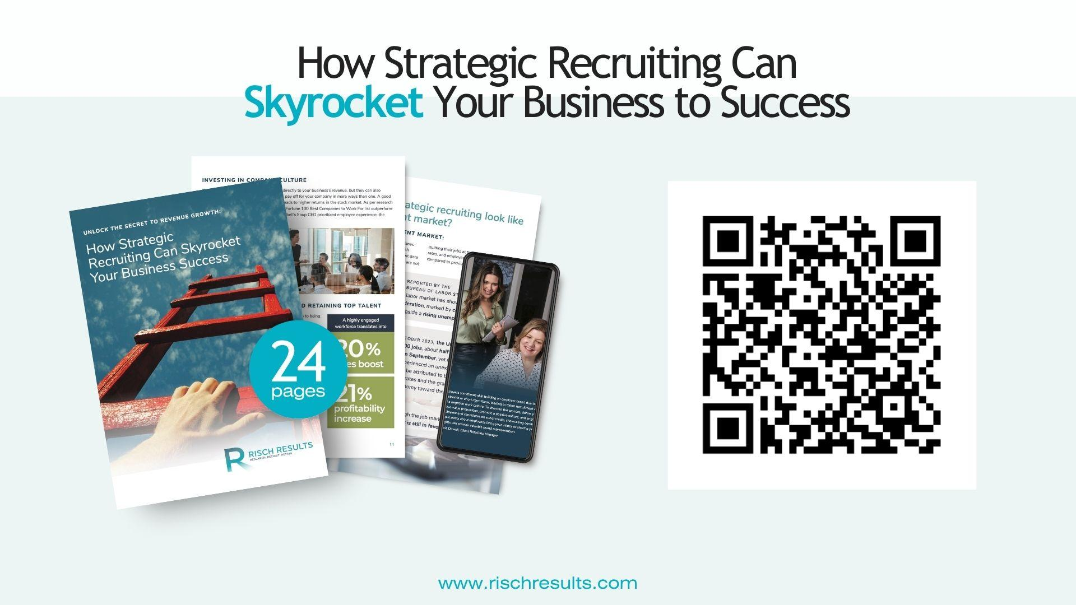
For More State of the Market

Slide 77

We recruit diverse talent so you can build and retain a high performing team
Risch Results is a certified woman-owned retained search firm that partners with leaders to find great talent.
Offering a retained search model for senior level and leadership search and a fractional recruiting model for growing companies with consistent hiring needs throughout the year.
RischResults.com
972.839.9447
JoleneRisch@RischResults.com

Slide 78
Critical Risks for
Nonprofits 2024
Building Community Leaders, Impactful Nonprofits, and Thriving Communities
ntxnonprofits.org

Slide 79
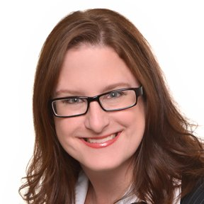
From Grassroots to Grown-up: Legal Strategies for Nonprofits to demonstrate Credibility on Paper and in Person
Margaret Apgar

Slide 80
Apgar Firm
Outside General Counsel Services for Nonprofits
Disclaimer: This material is for educational purposes only and does not constitute tax or legal advice. Viewers must consult their tax and legal advisors to review how this material may apply to their specific situation.

Slide 81
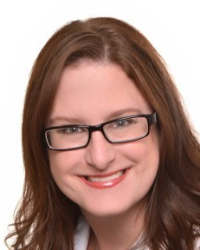
Thank You
Margaret Apgar
Apgar Firm
Outside General Counsel Services
margaret@apgarfirm.com
(214) 707-2791
linkedin.com/in/margaret-apgar-b5738539

Slide 82

The Worries of the Non-Profit CEO
How do I fill this form out correctly?
How do I step back from the day to day now that the organization has grown?
Is there some filing I have missed? Did I fill this form out correctly?
Am I being responsible with donor funds?
What if the Board doesn’t want me to run this organization anymore?

Slide 83

The Pitfalls of the Piecemeal Approach
Grassroots PHASE = All Hands On Deck.
  Focus is on activation not design
  Move fast and break things – let’s get this help to those in need STAT!
Growth Phase = Grown-Up on Paper.
  Built something impressive
  Desire to do more and do it better
  Need to be prepared for more sophisticated discussions and decisions.
Maintenance Phase = Well Oiled Machine.
  Cohesive plan aligned with your mission and core values.
  Ready for change, ready for anything!

Slide 84
Why Do You Need a Cohesive Risk Plan?

Slide 85
Mission Critical Areas
Mission and Core Values
Conflict & Risk Management
Finance
Contracts & 3rd Party Relationships
Compliance with Laws
Employment Matters
Governance

Slide 86

Conflict and Risk Management

Slide 87
Compliance with Laws

Slide 88
Contracts & Third-Party
Relationships

Slide 89
Finance

Slide 90
Corporate Governance

Slide 91
Employment Matters

Slide 92


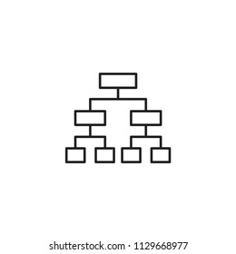


What is the Legal Process?
Info Gathering
Strategy
Decision Tree
Documentation
Peace of Mind

Slide 93

Goal = Peace of Mind and Ability to Focus on Strategic Enactment of Mission
You have the peace of mind that if something happens there will not be additional chaos or pain during a trauma that will disrupt what you built
You can focus on your mission and make strategic decisions

Slide 94
Thank You
Margaret Apgar
Apgar Firm
Outside General Counsel Services
margaret@apgarfirm.com
(214) 707-2791
linkedin.com/in/margaret-apgar-b5738539

Slide 95
Critical Risks for
Nonprofits 2024
Building Community Leaders, Impactful Nonprofits, and Thriving Communities
ntxnonprofits.org

Slide 96
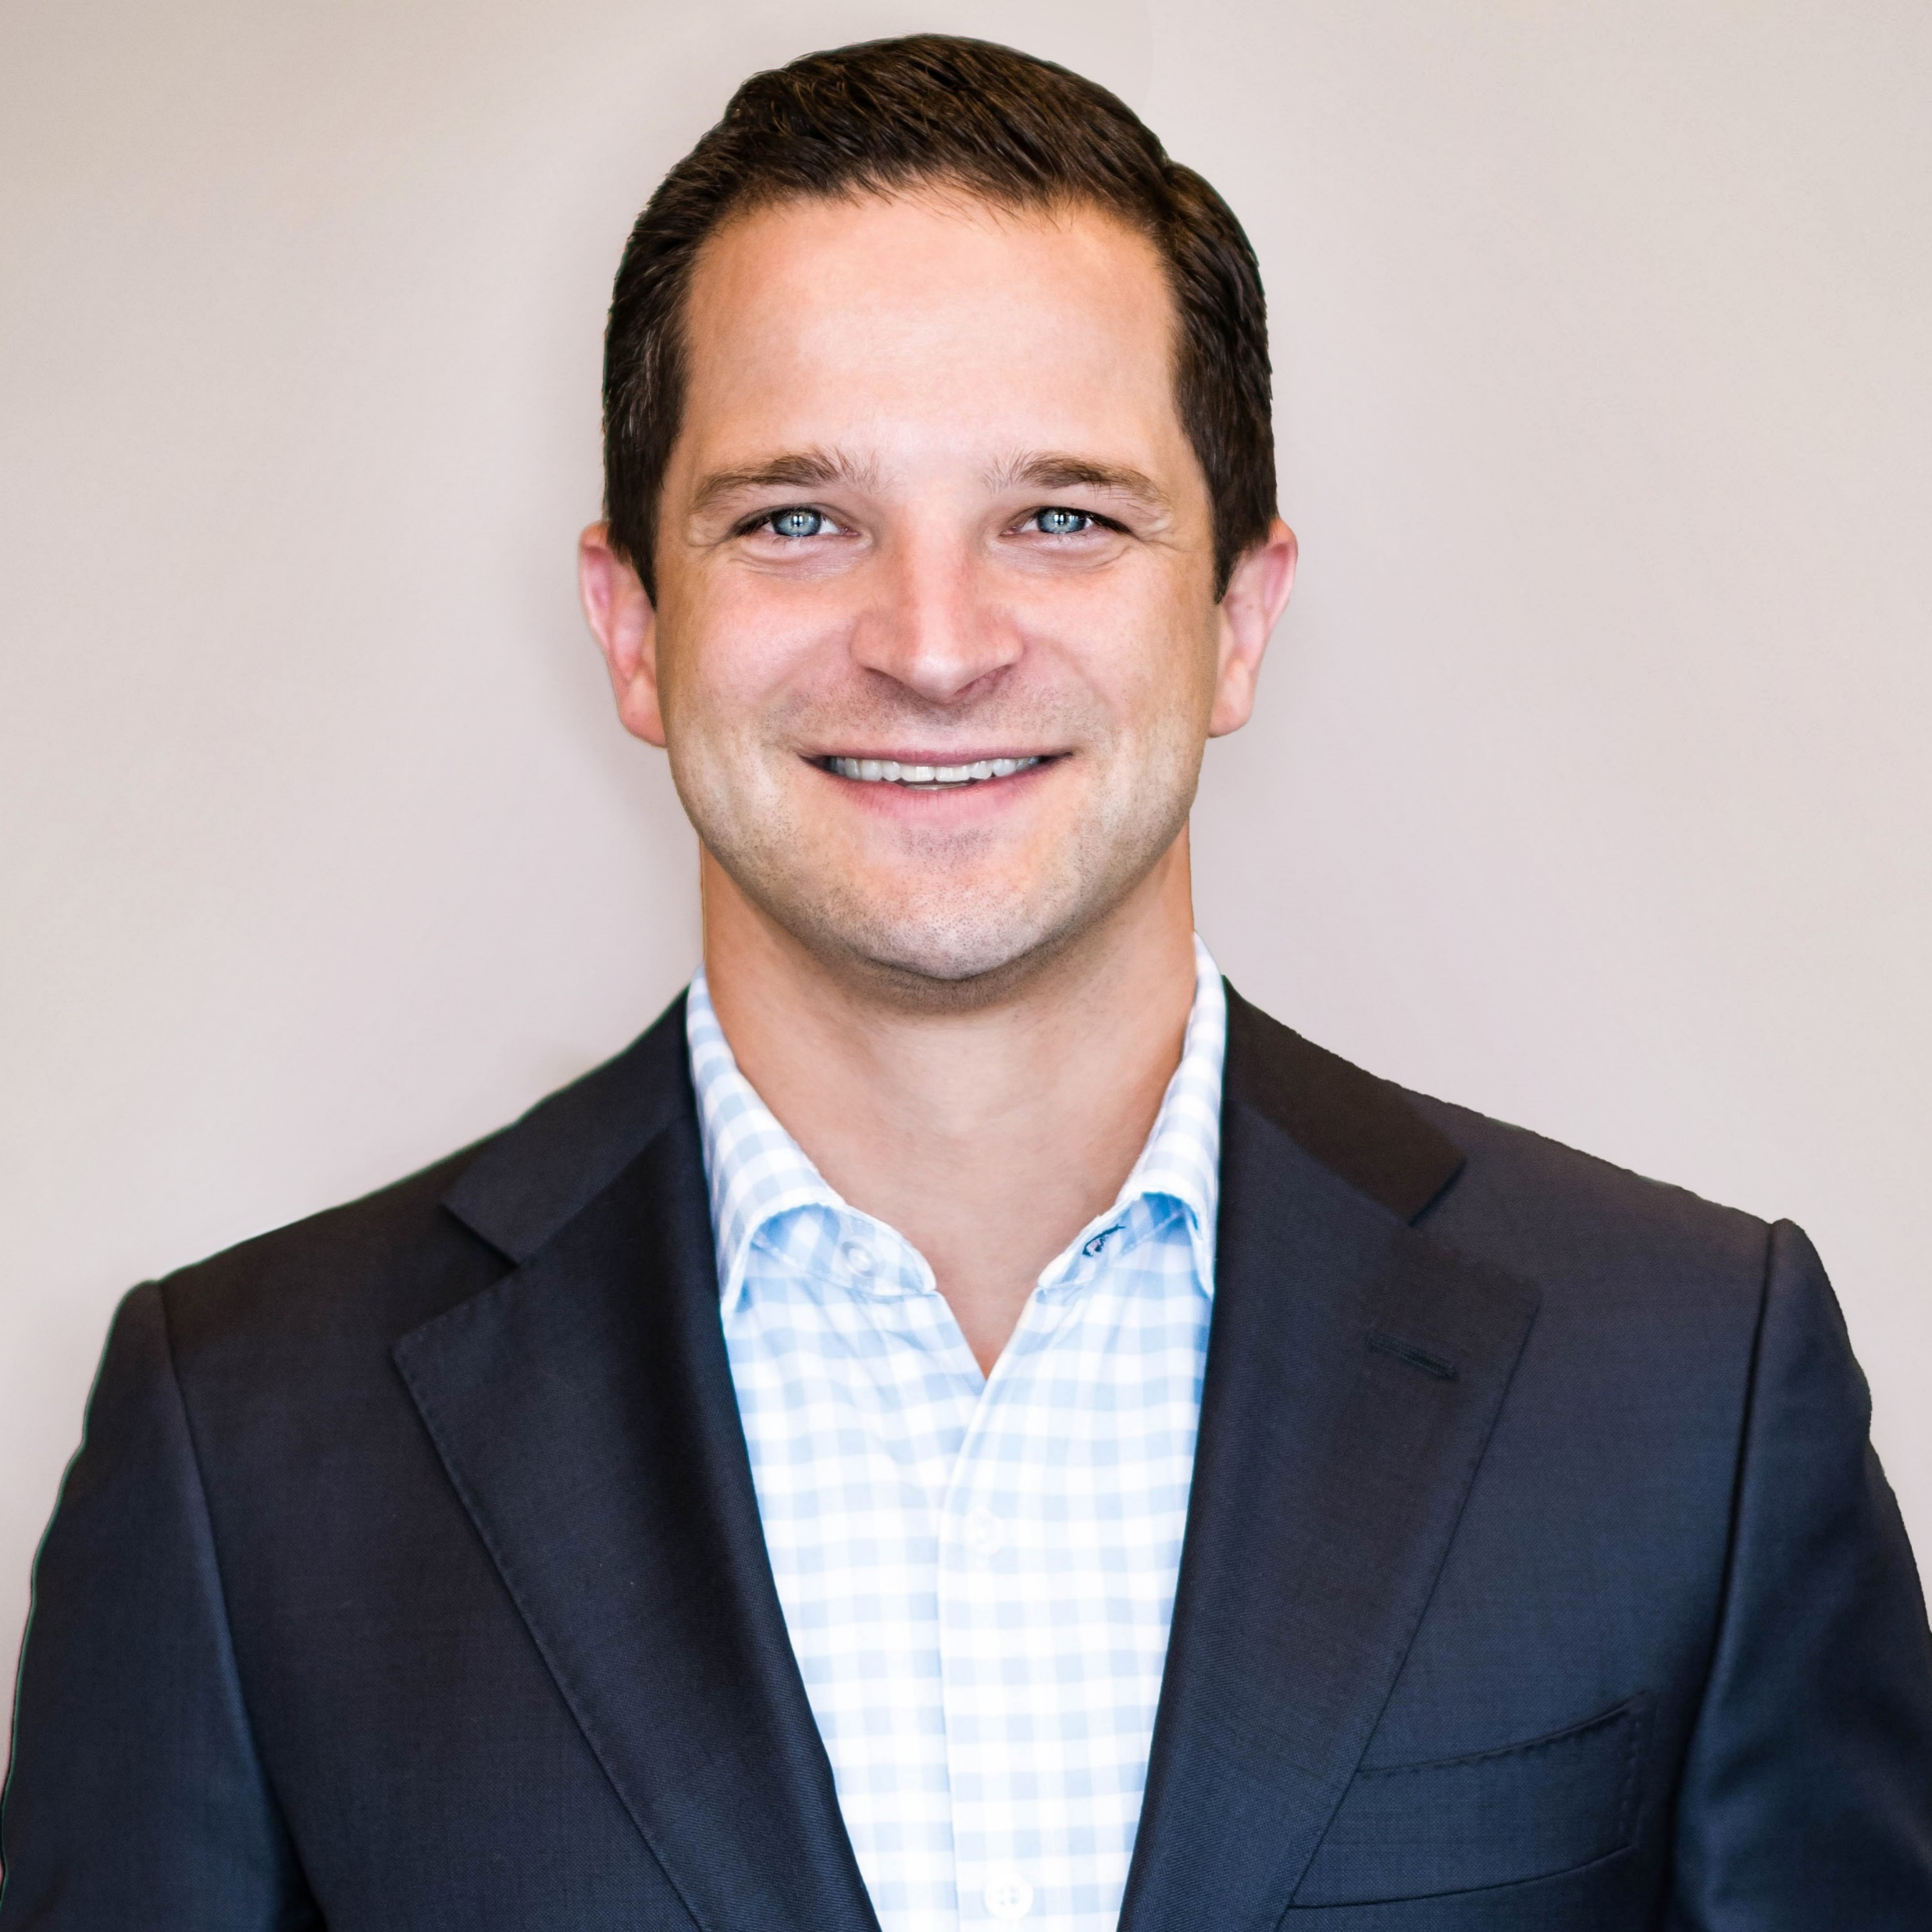
The “Hard Market” Playbook
Adam Sammons

Slide 97
Critical Risks for
Nonprofits 2024
Building Community Leaders, Impactful Nonprofits, and Thriving Communities
ntxnonprofits.org

Slide 98

Embracing the Texas Cybersecurity Framework
Kevin Mulhall

Slide 99
Texas Cybersecurity Framework: Presentation
Overview of Texas' approach to cybersecurity risk management

Slide 100

About Me
Senior Technical Customer Success Manager
TechSoup
Certified IT Professional
6x Microsoft (including MS Security)
AWS Cloud Practitioner
GCP
A+ & Network+

Slide 101
Cybersecurity
Worldwide spending on cybersecurity reached 133.7 billion in 2022 [Gartner]
Only 5% of company folders are properly protected (Varonis Systems)
Data breaches exposed 4.1 billion records in the first half of 2019 (RiskBased)
71% of breaches were financially motivated (Verizon)
What is the Texas Cybersecurity Framework?
The Texas Cybersecurity Framework was developed by the Texas Department of Information Resources in collaboration with other government entities and the private sector. It provides a common language to address and manage cybersecurity risk in a cost-effective way based on business needs without placing additional regulatory requirements on agencies.

Slide 102




How the Framework is Structured
Aligned with NIST framework
5 key functions
Security objectives
Maturity models
Identify, Protect, Detect, Respond, Recover
Contains specific security control objectives
Help determine maturity of objectives
Uses NIST framework as a foundation
The Texas Cybersecurity Framework is structured using NIST alignment, key functions, security objectives, and maturity models to help manage cybersecurity risk.

Slide 103
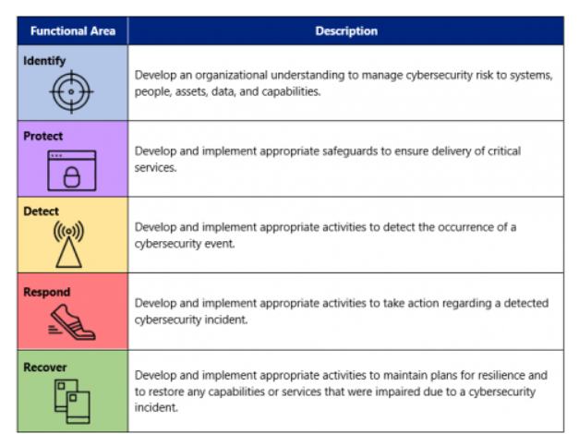
Framework Functions
Notes:
- Identify
Determine cybersecurity risks to systems, assets, data, and capabilities
- Protect
Develop safeguards to ensure delivery of critical services
- Detect
Implement activities to identify cybersecurity events
- Respond
Take action to contain the impact of potential cybersecurity incidents
- Recover
Restore capabilities or services impaired due to a cybersecurity incident

Slide 104
Maturity Model
Ad hoc
Defined
Managed
Lowest level of process maturity - processes are ad hoc and unorganized.
Basic processes are defined and documented, but not standardized across the organization.
Processes are monitored, measured, and managed organization-wide.
Optimized
Levels
Continuous process improvement and optimization takes place.
Maturity model outlines increasing maturity across defined levels.

Slide 105
Security Control Objectives
Identify security control objectives
  Objectives that help identify cybersecurity risks
Protect security control objectives
  Objectives that help protect systems and assets
Detect security control objectives
  Objectives that help detect cybersecurity events
Respond security control objectives
  Objectives that help respond to detected cybersecurity incidents
Recover security control objectives
  Objectives that help recover from cybersecurity incidents

Slide 106
Texas Cybersecurity Framework (TCSF)
Security Control Objectives and Definitions
Functional Area | Security Objective | Definition
IDENTIFY | Privacy and Confidentiality | Ensuring the appropriate security of retained information and approved sharing under defined conditions with required safeguards and assurance. Includes the requirements of HIPAA, Texas Business & Commerce Code, and agency defined privacy policies that include and expand upon regulatory and legal requirements for establishing contractual/legal agreements for appropriate and exchange and protection.
 | Data Classification | Data classification provides a framework for managing data assets and information resources based on utility to the organization, intrinsic financial value and impact of loss and other associated risks. To apply the appropriate levels of protection as required by state and federal law as well as proprietary, ethical, operational, and privacy considerations, data, whether electronic or printed, must be classified. The data owner should consult with the Information Security organization and legal counsel on the classification of data as Restricted, Confidential, Agency- Internal, or Public. Consistent use of data classification reinforces with users the expected level of protection of data assets in accordance with required security policies.
 | Critical Information Asset Inventory | Identification and prioritization of all of the organization's information assets so that they are prioritized according to criticality to the business, so that protections can be applied commensurate with the assets importance.
 | Enterprise Security Policy, Standards and Guidelines | Maintain the organization’s security policy framework, standards, and guidelines. Defines the acceptable use policy for agency information resources. Contributes to the definition of enterprise standards and secure configuration standards to ensure alignment to security specifications and risk management requirements. There will be situations where the strict application of an information security standard would significantly impair the functionality of a service. The exception management process provides a method for evaluating the risks associated with non- compliant conditions and tracking the exception until expiration.
 | Control Oversight and Safeguard Assurance | Catalog the security activities that are required to provide the appropriate security of information and information resources throughout the Enterprise. Evaluate the control activities that have been implemented in terms of maturity, scope/breadth of implementation, effectiveness or associated deficiency to assure required protection levels as specified by security policy, regulatory/legal requirements, compliance mandates, or organizational risk thresholds. Ensure that control activities are performed as required and performed in a manner that is auditable and verifiable. Identify control activities that are not implemented or are not effective at achieving the defined control objectives. Oversee the implementation of required controls to ensure ongoing audit readiness and effective control implementations.

Slide 107
Functional Area | Security Objective | Definition
 | Information Security Risk Management | The assessment and evaluation of risk within the information resources and technology to ensure that business operations are capable of delivering programs and services efficiently and effectively within acceptable tolerances potential negative outcomes.
 | Security Oversight and Governance | The set of responsibilities and practices exercised by the board and executive management with the goal of providing strategic direction, ensuring that objectives are achieved, ascertaining that risks are managed appropriately and verifying that the enterprise's resources are used responsibly.
 | Security Compliance and Regulatory Requirements Management | Monitor the legislative and industry landscape to ensure security policy is updated in consideration of changes that are pertinent or applicable to the organization. Facilitate any validation audits, assessments or reporting that is necessary to assure compliance to applicable laws, regulations, or requirements. Includes the HIPAA Privacy Office(r), IRS Safeguard Reviews, and responses to third party inquiries into the security of the organization.
 | Cloud Usage and Security | The assessment and evaluation of risk with the use of "cloud" technologies including Software as a Service (SAAS), Platform as a Service (PAAS), and Information as a Service (IAAS), to ensure that business operations are capable of delivering programs and services efficiently and effectively within acceptable tolerances potential negative outcomes.
 | Security Assessment and Authorization / Technology Risk Assessments | Evaluate systems and applications in terms of design and architecture in conjunction with existing or available controls to ensure that current and anticipated threats are mitigated within acceptable risk tolerances. Includes an analysis of in-place systems periodically or when significant change occurs as well as the analysis of the introduction of new technology systems.
 | External Vendors and Third Party Providers | Evaluation of third party providers and external vendors to ensure security requirements are met for information and information resources that will be transmitted, processed, stored, or managed by external entities. Includes contract review as well as the development of service level agreements and requirements.
PROTECT | Enterprise Architecture, Roadmap and Emerging Technology | An enterprise information security architecture that is aligned with Federal, State, Local and agency data security and privacy requirements. The integration of information security requirements and associated security controls into the information security architecture helps to ensure that security considerations are addressed early in the system development life cycle and are directly and explicitly related to mission/business processes. Using a roadmap and emerging technology evaluation process, the Information Security Program will stay abreast of the continued evolution of security solutions, processes, and technology to identify continuous, ongoing ways to deliver technology and information securely.

Slide 108
Functional Area | Security Objective | Definition
 | Secure System Services, Acquisition and Development | Ensure that the development and implementation of new systems meets the requirements necessary to assure the security of information and resources.
 | Security Awareness and Training | Define, prepare, deliver, and facilitate an ongoing awareness campaign utilizing a wide variety of mediums and delivery mechanisms to effectively and constantly educate the organization on security related information, threats, and technology risks.
 | Privacy Awareness and Training | Define, prepare, deliver, and facilitate an ongoing awareness campaign utilizing a wide variety of mediums and delivery mechanisms to effectively and constantly educate the organization on privacy requirements and information related to the protection of privacy risks and protections.
 | Cryptography | Establish the rules and administrative guidelines governing the use of cryptography and key management in order to ensure that data is not disclosed or made inaccessible due to an inability to decrypt.
 | Secure Configuration Management | Ensure that baseline configurations and inventories of information systems (including hardware, software, firmware, and documentation) are established and maintained throughout the respective system development life cycles. Establishes and enforces security configuration settings for information technology products employed in information systems. Ensures all systems are operating under configurations that have been agreed upon according to organizational risk management.
 | Change Management | Establishes a set of rules and administrative guidelines to manage changes in a rational and predictable manner. In addition, it provides for the necessary documentation of any changes made so as to reduce any possible negative impact to the Users of IR systems. Changes include, but are not limited to implementation of new functionality, interruption of service, repair of existing functionality, and the removal of existing functionality.
 | Contingency Planning | Plans for emergency response, backup operations, and post-incident occurrence recovery for information systems are established, maintained and effectively implemented to ensure the availability of critical information resources and continuity of operations in emergency situations. Backing up data and applications is a business requirement. It enables the recovery of data and applications in the event of loss or damage (natural disasters, system disk and other systems failures, intentional or unintentional human acts, data entry errors, or systems operator errors).
 | Media | The protection of digital and non-digital information system media, the assurance that access to information on information system media is limited to authorized users, and requirements that information system media is sanitized or destroyed before disposal or release for reuse. The

Slide 109
Functional Area | Security Objective | Definition
 |  | requirement that safeguards are in place to restrict access to Information system media which includes both digital media (e.g., systems, diskettes, magnetic tapes, external/removable hard drives, flash/thumb drives and other portable mass storage devices, compact disks, and digital video disks) and non-digital media (e.g., paper, microfilm). This standard applies to mobile computing and communications devices with information storage capability (e.g., notebook/laptop computers, personal digital assistants, cellular telephones, digital cameras, and audio recording devices) as well as data center systems and servers.
 | Physical and Environmental Protection | Assure that physical access to information systems, equipment, and the respective operating environments is limited to authorized individuals. Protect the physical locations and support infrastructure for information systems to ensure that supporting utilities are provided for to limit unplanned disruptions. Protect information systems against environmental hazards and provide appropriate environmental controls in facilities containing information systems.
 | Personnel Security | Ensuring that individuals responsible for agency information are identified and their responsibilities are clearly defined. Any individuals occupying positions of responsibility within the agency (including third-party service providers) are trustworthy and meet established security criteria for those positions. Ensuring that information resources are protected during and after personnel actions such as terminations and transfers. Employing formal sanctions for personnel failing to comply with security policies and procedures.
 | Third-Party Personnel Security | Requires all third party providers to comply with all security policies and standards. Third-party providers include, for example, service bureaus, contractors, and other organizations providing information system development, information technology services, outsourced applications, and network and security management. Establishes personnel security requirements including roles and responsibilities with limits on access requirements defined in accordance to least privileged and data minimization methodologies. Monitors providers for compliance.
 | System Configuration Hardening and Patch Management | Ensure that systems are installed and maintained in a manner that prevents unauthorized access, unauthorized use, and service disruptions by configuring operation systems and software with appropriate parameters. Includes the removal of default accounts/passwords, disablement of unnecessary protocols/ports/services, and the ongoing distribution and installation of service packs/patches.
 | Access Control | Processes used to ensure access to applications, servers, databases, and network devices in the environment is limited to authorized personnel. Access is to be limited to authorized users, processes acting on behalf of authorized users, or authorized devices. Authorized users are further limited to the types of transactions and functions that they are permitted to exercise.

Slide 110
Functional Area | Security Objective | Definition
 |  | Session limits, lockout features for failed login attempts, account expirations and disabling unused accounts are controls that provide access control.
 | Account Management | Account Management establishes the standards for the creation, monitoring, control, and removal of accounts. A request process for accounts that includes authorization, approval for access by data owners, and acknowledgement of the user of their responsibilities are controls that assure proper account management. Periodic reviews of access entitlements as well as prompt removal of access during role change or employment termination are also controls that are part of account management.
 | Security Systems Management | The design, implementation, configuration, administration, maintenance, monitoring, and ongoing support of security systems used to enforce security policy and provide security services. Systems include firewalls, Intrusion Prevention Systems (IPS), Internet Proxy Servers, Security Information and Event Management (SIEM) systems, and other control enforcement or monitoring systems.
 | Network Access and Perimeter Controls | Network equipment such as servers, workstations, routers, switches and printers should be installed in a manner that prevents unauthorized access while limiting services to only authorized users. A perimeter should be established to delineate internal systems and prevent unauthorized external parties from tampering, attempting access or connecting without approved remote access methods.
 | Internet Content Filtering | The enforcement of controls used to block access to Internet websites based upon categories of content, application types and granular application functions, time of day or amount of utilization, or the dynamically updated reputation of the destination. Bandwidth Preservation – The Local Area Network (LAN) and Wide Area Network (WAN) resources within the Agency locations are limited and heavily utilized for conducting business. The Bandwidth Preservation aspect of Internet Content Filtering is designed to remove unnecessary bandwidth usage from the network by blocking access to sites that are not business related and consume excessive bandwidth. Inappropriate Content – The Internet contains content that is inappropriate in nature and unacceptable for access in the workplace. The Inappropriate Content service within the Internet Content Filtering function is intended to support the Management and Human Resources policies to provide a non-threatening or offensive workplace environment. Additionally, the Inappropriate Content service provides management and monitoring tools for the enforcement of waste and abuse of state resources. Malware and Cyber-Threat Prevention- Internet content is often used to propagate malware and cyber-threats. Even the most popular Internet sites have become infected and used to spread malicious code. The Malware and Cyber-Threat Prevention aspect of Internet Content Filtering is designed to prevent the infection and spread of malware through Internet content.

Slide 111
Functional Area | Security Objective | Definition
 | Data Loss Prevention | Solution designed to detect and prevent potential data breach incidents where sensitive may be disclosed to unauthorized personnel by malicious intent or inadvertent mistake. Detection of data at risk can be performed while in use at the endpoint, while in motion during transmission across the network, and while at rest on data storage devices.
 | Identification and Authentication | The verification of the claimed identity of users, processes, or devices as a prerequisite to permitting access. Verification can be performed by accepting a password, a Personal Identification Number (PIN), smart card, biometric, token, exchange of cryptographic keys, etc. Passwords are the most common authentication factor used in the identification process for users. Password standards establish the rules for the creation, length and complexity requirements, distribution, retention and periodic change as well as suspension or expiration of authenticators.
 | Spam Filtering | As digital messaging (e-mail, cellular messaging, etc.) has become an integral part of the business process, its abuse has also grown. This abuse often is manifested as “SPAM” or “junk” messaging which has the potential to, beyond its annoying nature, slow-down and/or clog the infrastructure required to process electronic messages. In addition, “SPAM” is often used as a transmission vehicle in the migration of malicious code infections. To limit the effects of “SPAM”, messages will be examined for content and filtered as required.
 | Portable and Remote Computing | Computing is no longer limited to traditional workstations. Mobile computing has introduced tablets, smartphones, handhelds and other computing devices designed to be portable and facilitate productivity for remote users. Traditional controls still apply in many areas, but additional considerations must be made for portable devices and the specific configuration and enforcement of controls will likely require special consideration.
 | System Communications Protection | The control, monitoring, management and protection of communications and transmissions between information systems. Includes network architecture considerations, inventory of confidential and restricted data transmissions, permitted inbound and outbound Internet communications, permitted inbound and outbound extranet and intranet communications, as well as communications between agencies. Establishes the requirements for protections such as link encryption, secure file transmission protocols, retention of files on source and destination systems, integrity validation, and restrictions for access at all levels (i.e. user/process, system, and network).
 | Information Systems Currency | Ensures that the necessary knowledge, skills, hardware, software, and supporting infrastructure are available at a reasonable cost to support information systems operations. Includes the

Slide 112
Functional Area | Security Objective | Definition
 |  | monitoring and planning of future system developments that enable the organization to leverage modern technology and reduce technical debt.
DETECT | Vulnerability Assessment | Assessment and monitoring of vulnerability detection and remediation including patch management processes, configuration management, system, database and application security vulnerabilities. Test and evaluate security controls and security defenses to ensure that required security posture levels are met. Perform and/or facilitate ongoing and periodic penetration testing of security defenses. Evaluate results of various penetration tests to provide risk based prioritization of mitigation.
 | Malware Protection | The prevention, detection and cleanup of Malicious Code (including virus, worm, Trojan, Spyware and other similar variants). Protection is accomplished at varying layers including at the host, at the network, or at the gateway perimeter. Protection mechanisms must be updated periodically and frequently to address evolving threats and monitored to provide manual intervention where required.
 | Security Monitoring and Event Analysis | Analysis of security events and alerts as detected by the array of security enforcement devices and log collection facilities implemented throughout the Enterprise environment. System level events include server operating system security and system logs. Application level events include web application logs, application access logs, and other application associated log events. Security monitoring and analysis includes alert configuration and generation, event correlation as well as defining and distributing periodic reports and event statistical analysis. Also includes analysis of events from the Internet content filtering system, SPAM prevention system, email encryption system, and other security control devices to ensure appropriate protections of information and information resources. Security Monitoring and Event Analysis can include advanced functionality used to detect fraud within program areas and ensure client identity protection by collecting and analyzing data access correlated with system events information. The limits of this function are limited only by the data sources that are compiled and the resources devoted to the data analysis.
 | Audit Logging and Accountability | Processes, policies, and procedures that enable organizations to establish an accurate and verifiable record of system relevant actions whether manual or automated for investigatory and accountability purposes.
RESPOND | Cyber-Security Incident Response | Establishes an operational incident handling capability for information systems that includes adequate preparation, detection, analysis, containment, recovery, and response activities. The Incident Response program is used to track, document, and report incidents to appropriate officials and/or authorities.

Slide 113
Functional Area | Security Objective | Definition
 | Privacy Incident Response | Management of events, issues, inquiries, and incidents when detected or reported to include all phases from investigation through resolution. Responsible for notifying and escalating incidents to appropriate personnel and coordinating activities to ensure timely isolation and containment, impact analysis, and any resulting remediation / resolution requirements. Incidents include but may not be limited to privacy breach, loss, theft, unauthorized access, malware infections, and occurrences of negligence, human error, or malicious acts.
RECOVER | Disaster Recovery Procedures | Managing the recovery of data and applications in the event of loss or damage (natural disasters, system disk and other systems failures, intentional or unintentional human acts, data entry errors, or systems operator errors).

Slide 114




Additional Resources
- TCF Control Objectives and Definitions
- Information Security Plan
- SPECTRIM Portal
- About File Formats
Access assessments and view security posture
Learn about supported file formats
Provides detailed information on each control objective
Outlines information security program and initiatives

Slide 115
Critical Risks for
Nonprofits 2024
Building Community Leaders, Impactful Nonprofits, and Thriving Communities
ntxnonprofits.org

Slide 116
Thank You to Our Collaborators

Slide 117
